Slide 1
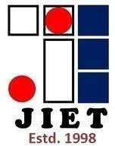
Student Management System using C++
JIND INSTITUTE OF ENGINEERING AND TECHNOLOGY – JIND Affiliated with Kurukshetra University

Slide 2
Submitted by
Rohit (2021217005)
Joji (2021217008)
Vishal Kumar (2021217010)

Slide 3

The education industry relies on Student Information Systems (SIS) to manage student records efficiently. The Student Management System (SMS) in C++ allows users to add, edit, and search for student details using a menu-driven interface. It utilizes an array of structures to store student attributes.
Introduction:

Slide 4

Components used:
Dev-C++ C++ Compiler Command prompt or Terminal to run the program
Technical requirements: Knowledge of C++ with OOP principals and classes
Project Requirements:
File handling: reading and writing data to a file. Student Management system functionality: Insert, Display, modify, search, and delete student record operations performed by the user. User input/output: input will be gathered for student record operations and navigation of the student record program. Output in a terminal will be used to display Instructions to the users of system management system data.

Slide 5
What classes will be utilized?
Class student management program utilizes a multitude of classes that each have their responsibilities:
Program Breakdown
We are including all the necessary libraries in this program to avoid any kind of compilation error. The while loop above will only execute when the option selected is not equal to 6 and printing line by line the available operations, add new student, student login, faculty login, proctor login, admin view, exit for 6th option, and entering the option.

Slide 6
Key Aspects of the Future Scope of Student Management System
The future scope of student management systems is immense and holds enormous potential for revolutionizing the educational landscape. As schools seize these advancements, the future scope of student management systems will continue to grow and play a crucial role in modeling the future of education.
In today’s fast-moving world, the education sector is continuously witnessing remarkable revolutions. A crucial aspect of schools today, Student Management Systems have advanced from mere administrative tools to exhaustive platforms that simplify operations and improve student experiences. As we step into technological advancements, the future scope of Student Management Systems holds massive potential to revolutionize the way schools functions.

Slide 7
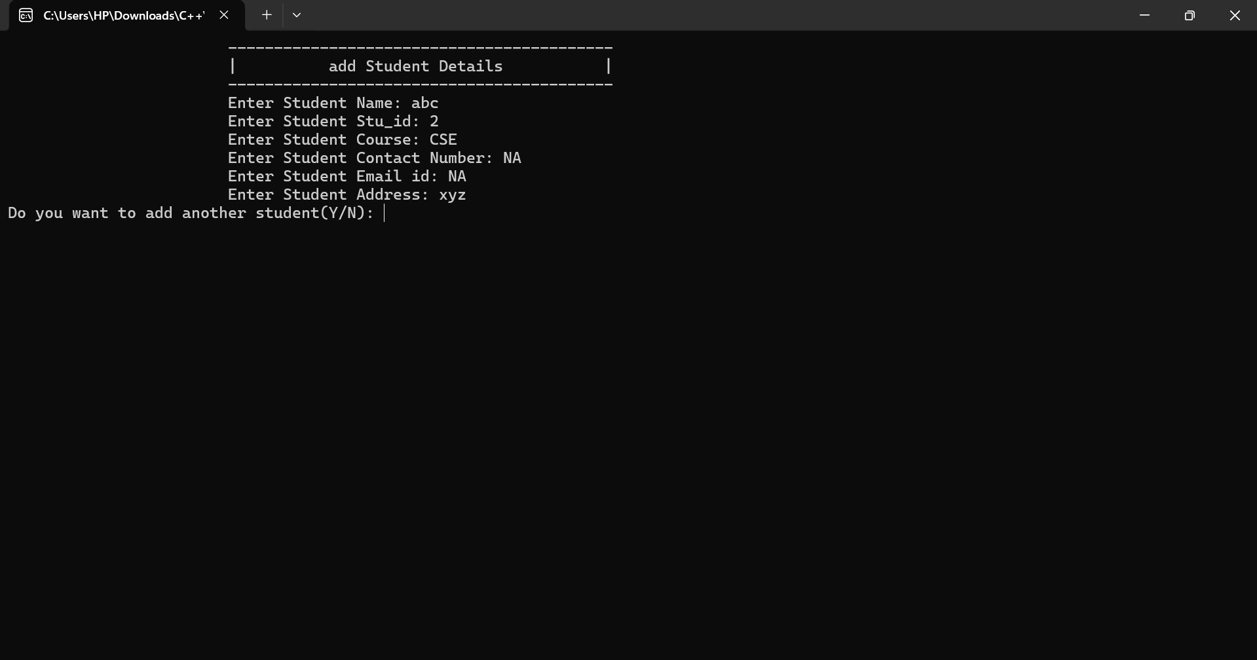
CONTENT IN PROJECT
The feature helps create comprehensive student records by inputting the student's name, roll number, and marks in five subjects. This enables easy monitoring of academic progress and saves time and effort.

Slide 8
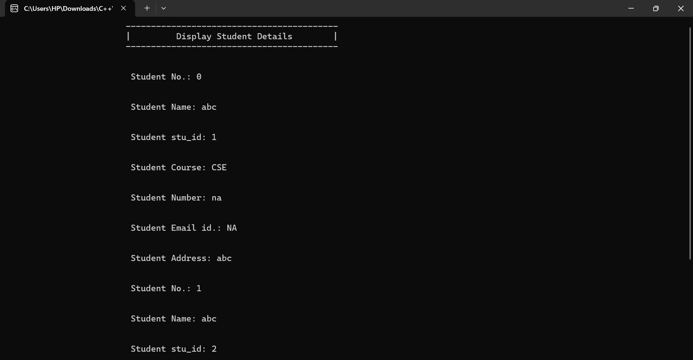
CONTENT IN PROJECT
Display student records
"Display student record" is a functionality commonly used in academic settings to provide an overview of a student's academic history, including their enrollment status, courses taken, and other related information. This feature is particularly useful for instructors and academic advisors who need to have a comprehensive view of a student's academic details. By accessing a student's record, they can identify any potential details, and provide appropriate information

Slide 9
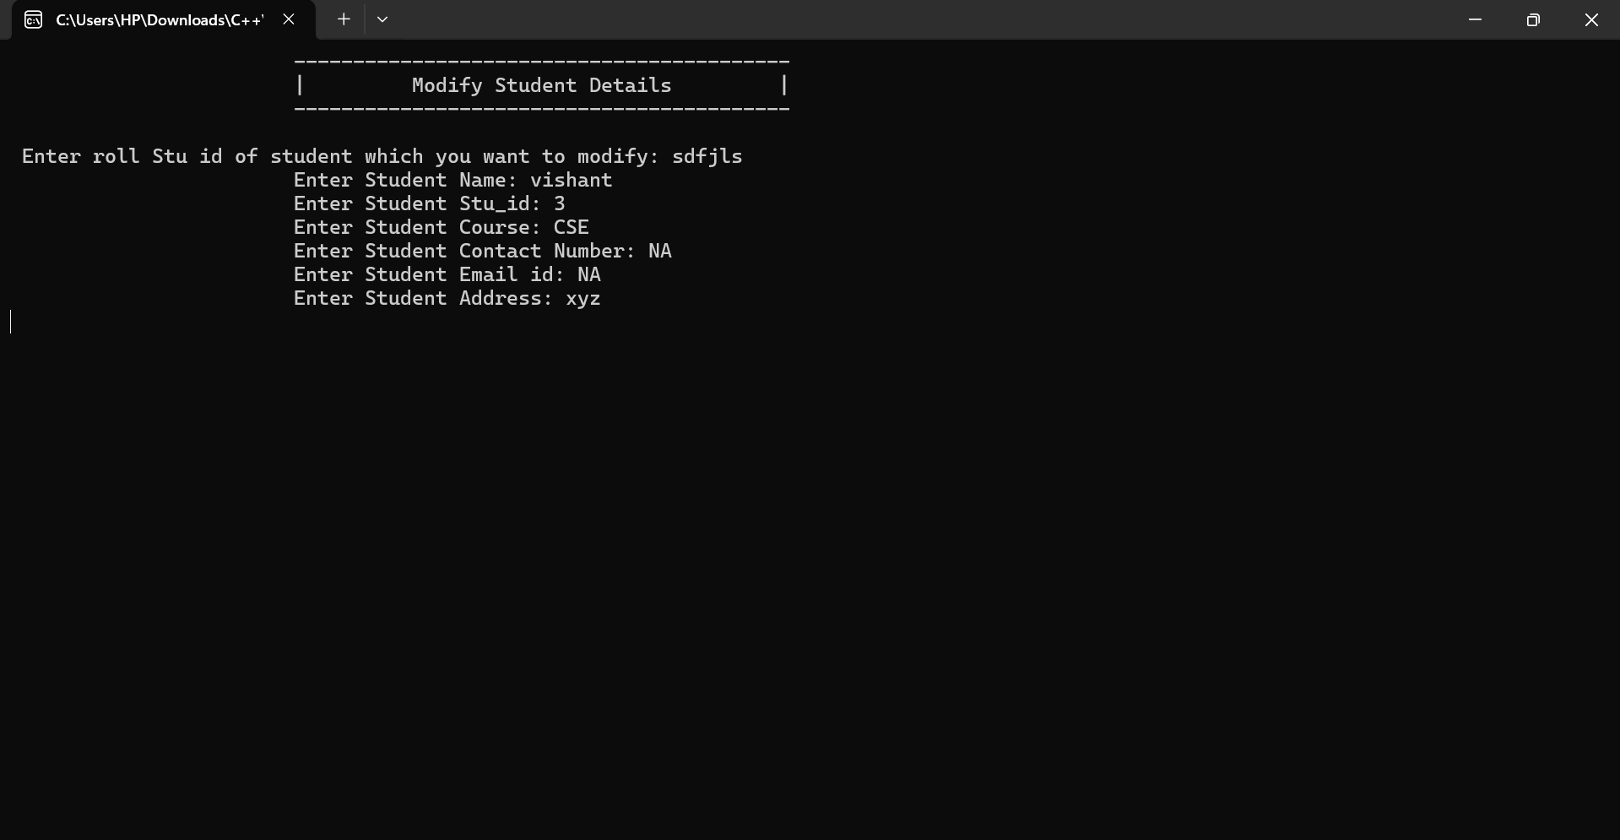
CONTENT IN PROJECT
Modify Record The
The "Modify Record" feature is a tool that enables authorized users to make changes to a student's information in a database. This feature is typically used when a student's details, such as their name, address, or phone number, have changed, or when there is a need to correct incorrect information. It is important to ensure that the changes made using this tool are accurate and up-to-date to avoid any discrepancies in the student's records. Additionally, only authorized personnel should have access to this feature to maintain the integrity of the database.

Slide 10
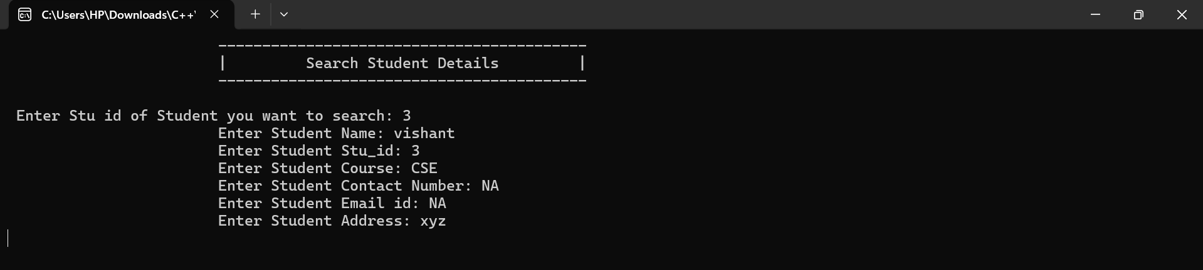
CONTENT IN PROJECT
Search Record
When we use the term "search", it refers to the process of looking for information or records related to a particular student. This process can involve using various search tools and techniques to locate the desired information, such as searching for a student's name or ID number in a database. Once the record has been located, it can be used to access important information about the student, such as their academic performance, attendance, and personal details.

Slide 11
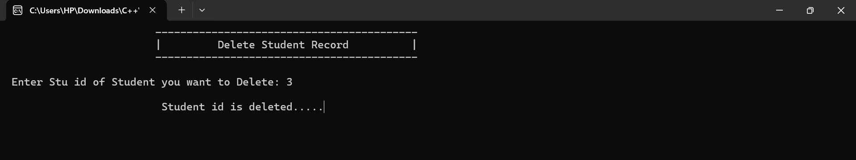
CONTENT IN PROJECT
Delete
The "delete" function is commonly used in various software applications, including educational ones, to remove mistakenly filled student records. This includes erroneous data such as incorrect contact information or grades. Caution should be exercised to ensure the correct record is removed. Always double-check before deleting to avoid losing important information.

Slide 12
CONTENT IN PROJECT
Exit
The term "exit" refers to a functionality that allows a user to terminate a process, close a window or tab, or quit an application or program. It is a crucial command used in various computer software and applications to close an active session and save the changes made. When the "exit" command is executed, the program or process is stopped, and any unsaved changes are either saved or discarded based on the application's settings or prompts. It is a simple yet powerful command widely used in the computing world for various purposes.

Slide 13
Thank you
Rohit (2021217005)
Joji (2021217008)
Vishal Kumar (2021217010)

